Slide 1
Finite-Difference Time-Domain (FDTD)
Howard

Slide 2
Outline
1-D FDTD
Order of Accuracy
1-D Wave Equation
- Dispersive approximation
- Magic time-step
Computational Electrodynamics
- Maxwell’s equations
- Yee’s grids
Summary
2-D FDTD
Extension to 2-D
TE & TM Mode
Dispersive Equations
2-D Yee’s Grid
Numerical Stability
Summary
Perfectly Matched Layers
Absorption Boundary Condition
Mur’s ABC
Perfectly Matched Layers(PML)

Slide 3
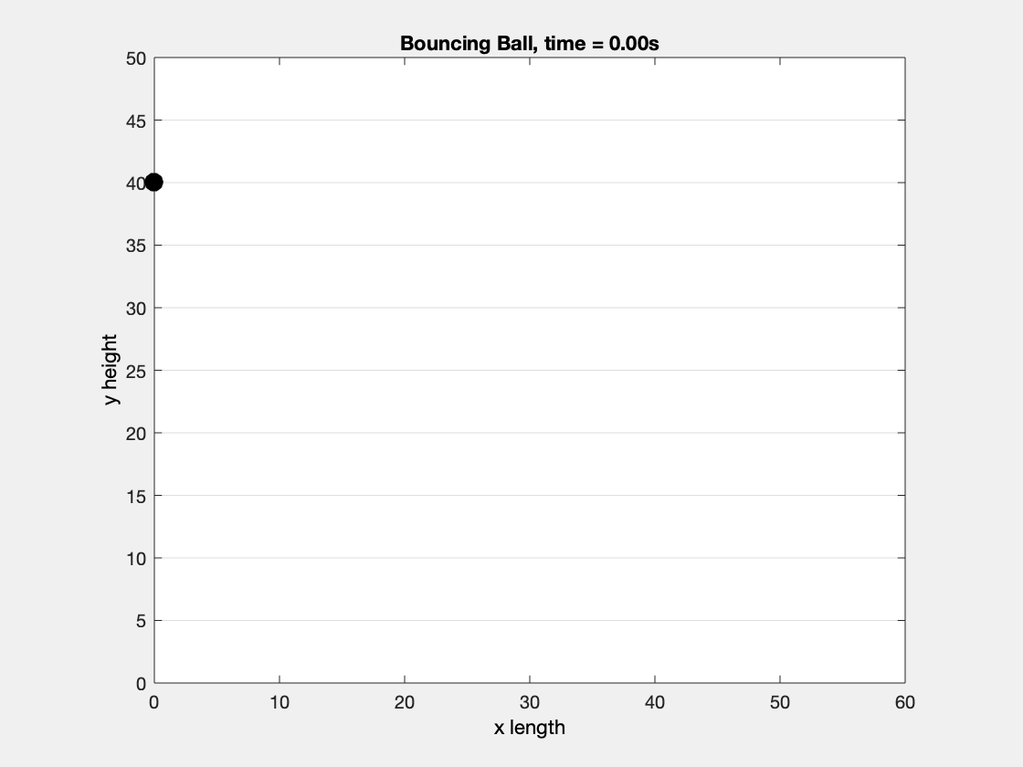
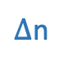
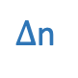
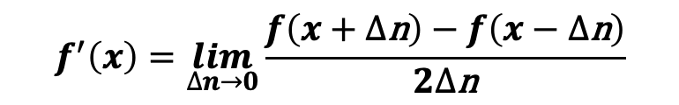
Continuous to discrete
Finite Difference
$$f^{′}\left(x\right)=\lim_{∆n→0}{\frac{f\left(x+∆\text{n}\right)−f\left(x−∆\text{n}\right)}{2∆\text{n}}}$$
$∆$n
f(x)
$∆$n
x
Notes:
接著簡單介紹一下連續跟離散的差異，以上次作業為例，
在自然界中的斜向拋射物體軌跡是連續的，每個時間間隔中還能再細分出時間，
並且沒辦法細分成最小時間間隔，這就是連續的，而電腦程式沒辦法直接打連續的方程式，
因此上次作業才把時間離散化，以dt的方式去描述物體軌跡
再舉一個為例，右邊看到微分是把前一個點減後一個點除上間隔，也就是斜率
如果能把這個間隔趨近於0，那微分就表示切線斜率，
因此模擬要越接近連續的現象，那關鍵就是模擬尺度的解析度夠不夠的問題

Slide 4
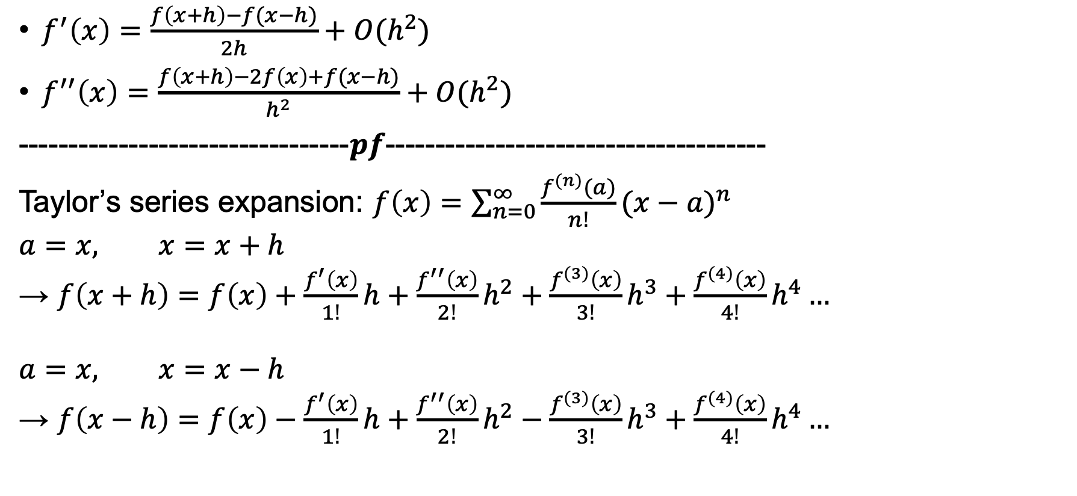
Order of Accuracy
$f^{′}\left(x\right)=\frac{f\left(x+h\right)−f(x−h)}{2h}+O(h^{2})$
$f^{′′}\left(x\right)=\frac{f\left(x+h\right)−2f\left(x\right)+f(x−h)}{h^{2}}+O(h^{2})$
---------------------------------$pf$--------------------------------------
Taylor’s series expansion: $f\left(x\right)=\sum_{n=0}^{∞}{\frac{f^{(n)}(a)}{n!}{(x−a)}^{n}}$
$$a=x, x=x+h$$ → $f\left(x+h\right)=f\left(x\right)+\frac{f^{′}\left(x\right)}{1!}h+\frac{f^{′′}\left(x\right)}{2!}h^{2}+\frac{f^{(3)}\left(x\right)}{3!}h^{3}+\frac{f^{(4)}\left(x\right)}{4!}h^{4}…$
$$a=x, x=x−h$$ → $f\left(x−h\right)=f\left(x\right)−\frac{f^{′}\left(x\right)}{1!}h+\frac{f^{′′}\left(x\right)}{2!}h^{2}−\frac{f^{(3)}\left(x\right)}{3!}h^{3}+\frac{f^{(4)}\left(x\right)}{4!}h^{4}…$

Slide 5

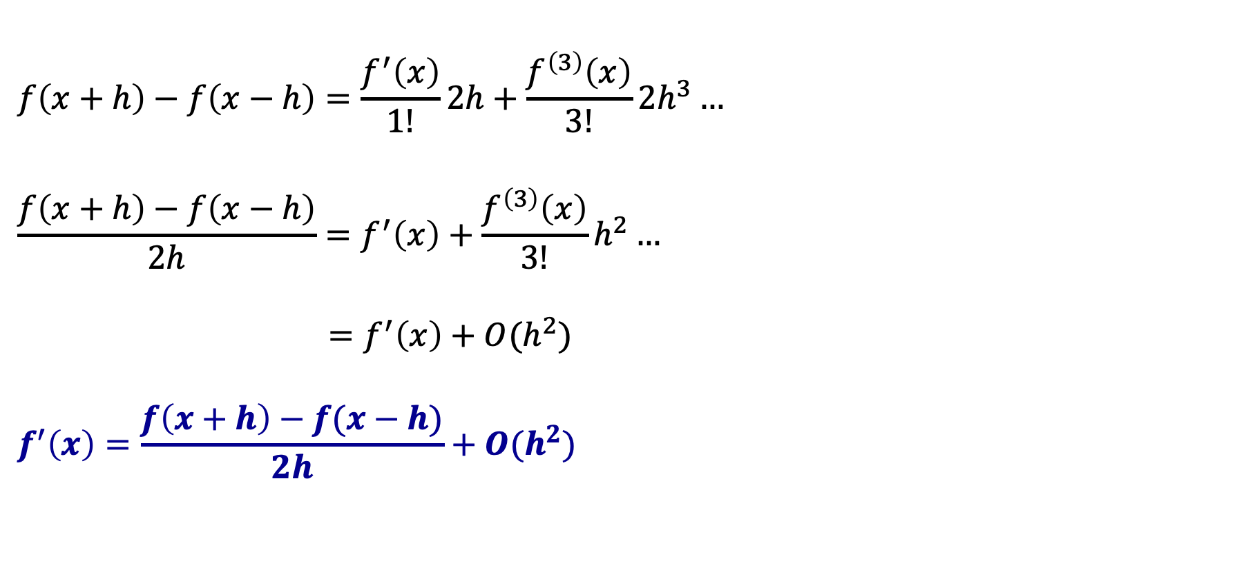
Order of Accuracy
$$f\left(x+h\right)−f\left(x−h\right)=\frac{f^{′}\left(x\right)}{1!}2h+\frac{f^{\left(3\right)}\left(x\right)}{3!}{2h}^{3}…$$
$$\frac{f\left(x+h\right)−f\left(x−h\right)}{2h}=f^{′}\left(x\right)+\frac{f^{\left(3\right)}\left(x\right)}{3!}h^{2}…$$ $=f^{′}\left(x\right)+O(h^{2})$
$$f^{′}\left(x\right)=\frac{f\left(x+h\right)−f(x−h)}{2h}+O(h^{2})$$

Slide 6

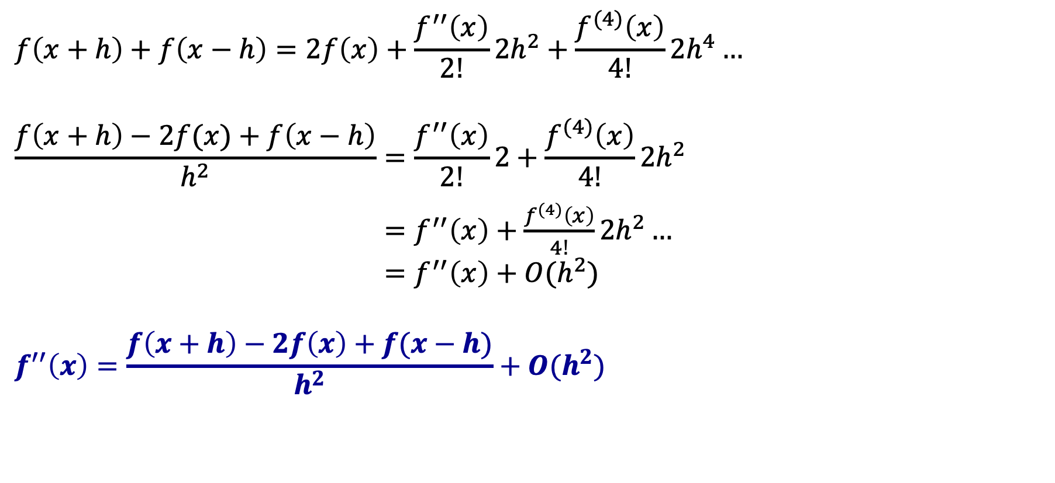
Order of Accuracy
$$f\left(x+h\right)+f\left(x−h\right)=2f\left(x\right)+\frac{f^{′′}\left(x\right)}{2!}{2h}^{2}+\frac{f^{(4)}\left(x\right)}{4!}{2h}^{4}…$$
$$\frac{f\left(x+h\right)−2f(x)+f\left(x−h\right)}{h^{2}}=\frac{f^{′′}\left(x\right)}{2!}2+\frac{f^{(4)}\left(x\right)}{4!}{2h}^{2}$$ $=f^{′′}\left(x\right)+\frac{f^{(4)}\left(x\right)}{4!}{2h}^{2}…$ $=f^{′′}\left(x\right)+O(h^{2})$
$$f^{′′}\left(x\right)=\frac{f\left(x+h\right)−2f\left(x\right)+f(x−h)}{h^{2}}+O(h^{2})$$
------------------------------$end of the pf$-----------------------------------

Slide 7
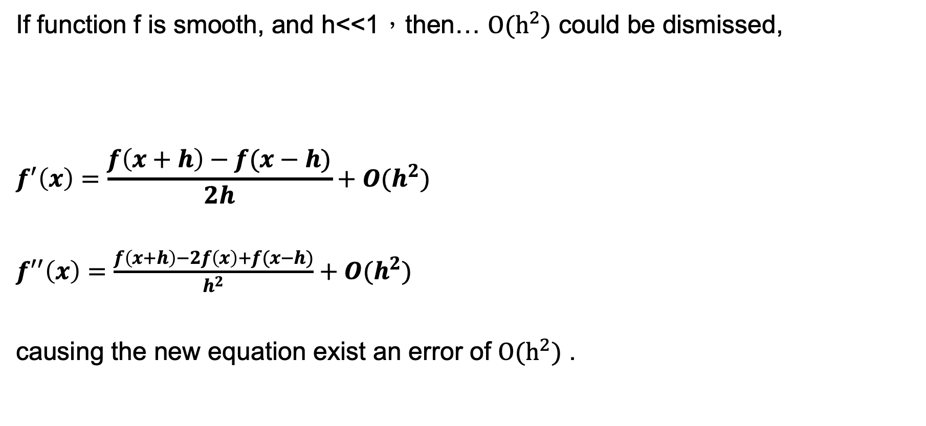
Order of Accuracy
If function f is smooth, and h<<1，then… $O(h^{2})$ could be dismissed,
$$f^{′}\left(x\right)=\frac{f\left(x+h\right)−f(x−h)}{2h}+O(h^{2})$$
$f^{′′}\left(x\right)=\frac{f\left(x+h\right)−2f\left(x\right)+f(x−h)}{h^{2}}+O(h^{2})$
causing the new equation exist an error of $O(h^{2})$ .

Slide 8
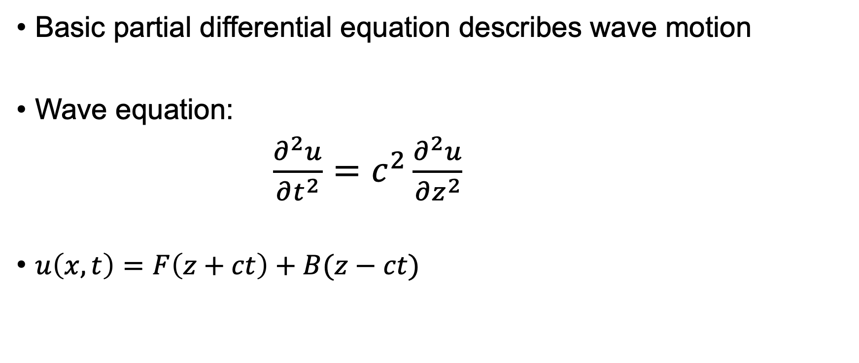
1-D Wave Equation
Basic partial differential equation describes wave motion
Wave equation:
$\frac{∂^{2}u}{∂t^{2}}=c^{2}\frac{∂^{2}u}{∂z^{2}}$
$u\left(x,t\right)=F\left(z+ct\right)+B(z−ct)$
One-way equation

Slide 9
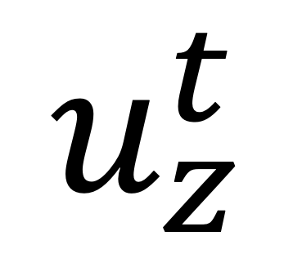
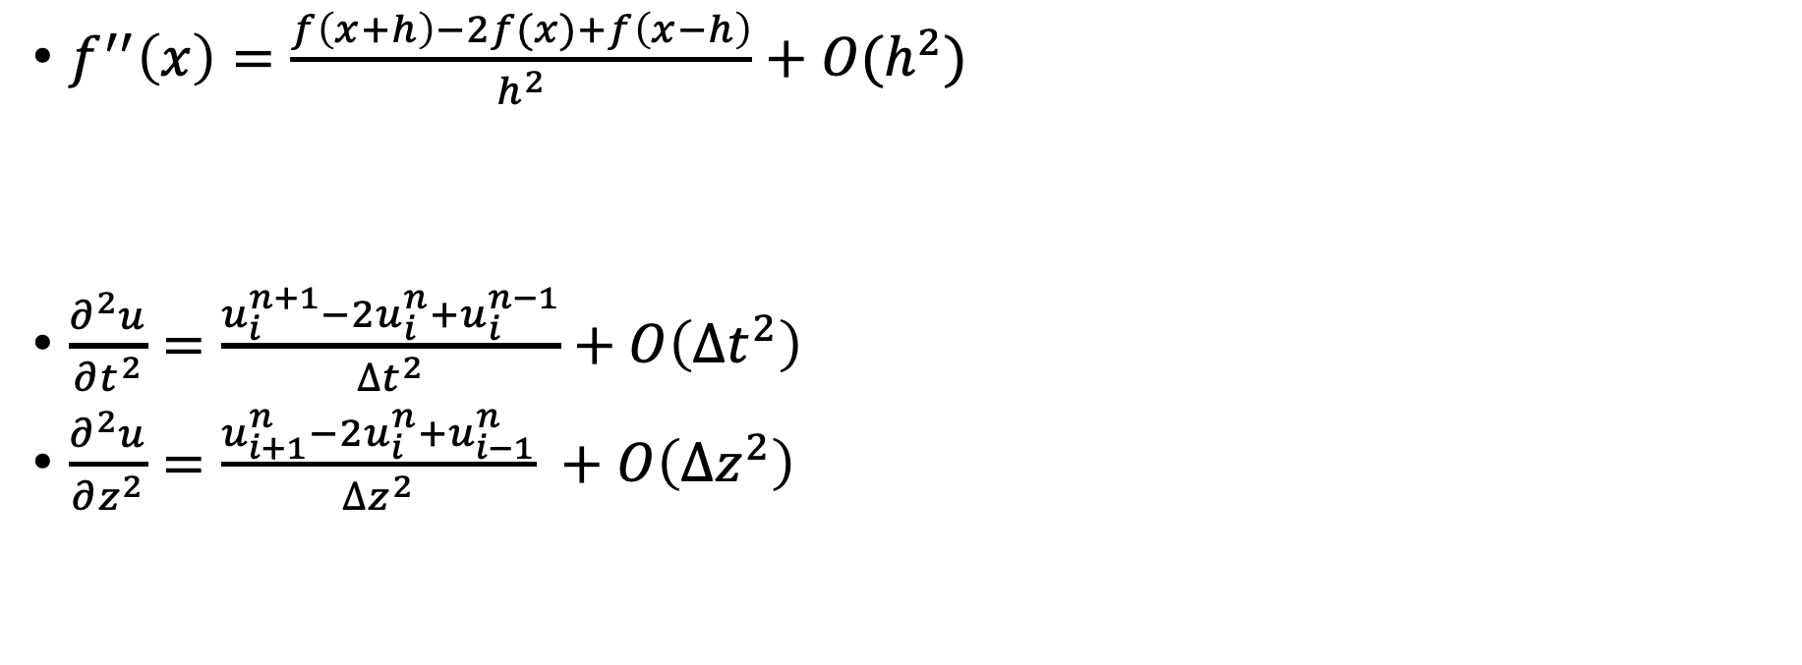
Dispersive approximation
$f^{′′}\left(x\right)=\frac{f\left(x+h\right)−2f(x)+f\left(x−h\right)}{h^{2}}+O(h^{2})$
$\frac{∂^{2}u}{∂t^{2}}=\frac{u_{i}^{n+1}−2u_{i}^{n}+u_{i}^{n−1}}{{∆t}^{2}}+O\left({∆t}^{2}\right)$
$\frac{∂^{2}u}{∂z^{2}}=\frac{u_{i+1}^{n}−2u_{i}^{n}+u_{i−1}^{n}}{{∆z}^{2}} +O\left({∆z}^{2}\right)$
Time observation point
$$u_{z}^{t}$$
Space position

Slide 10
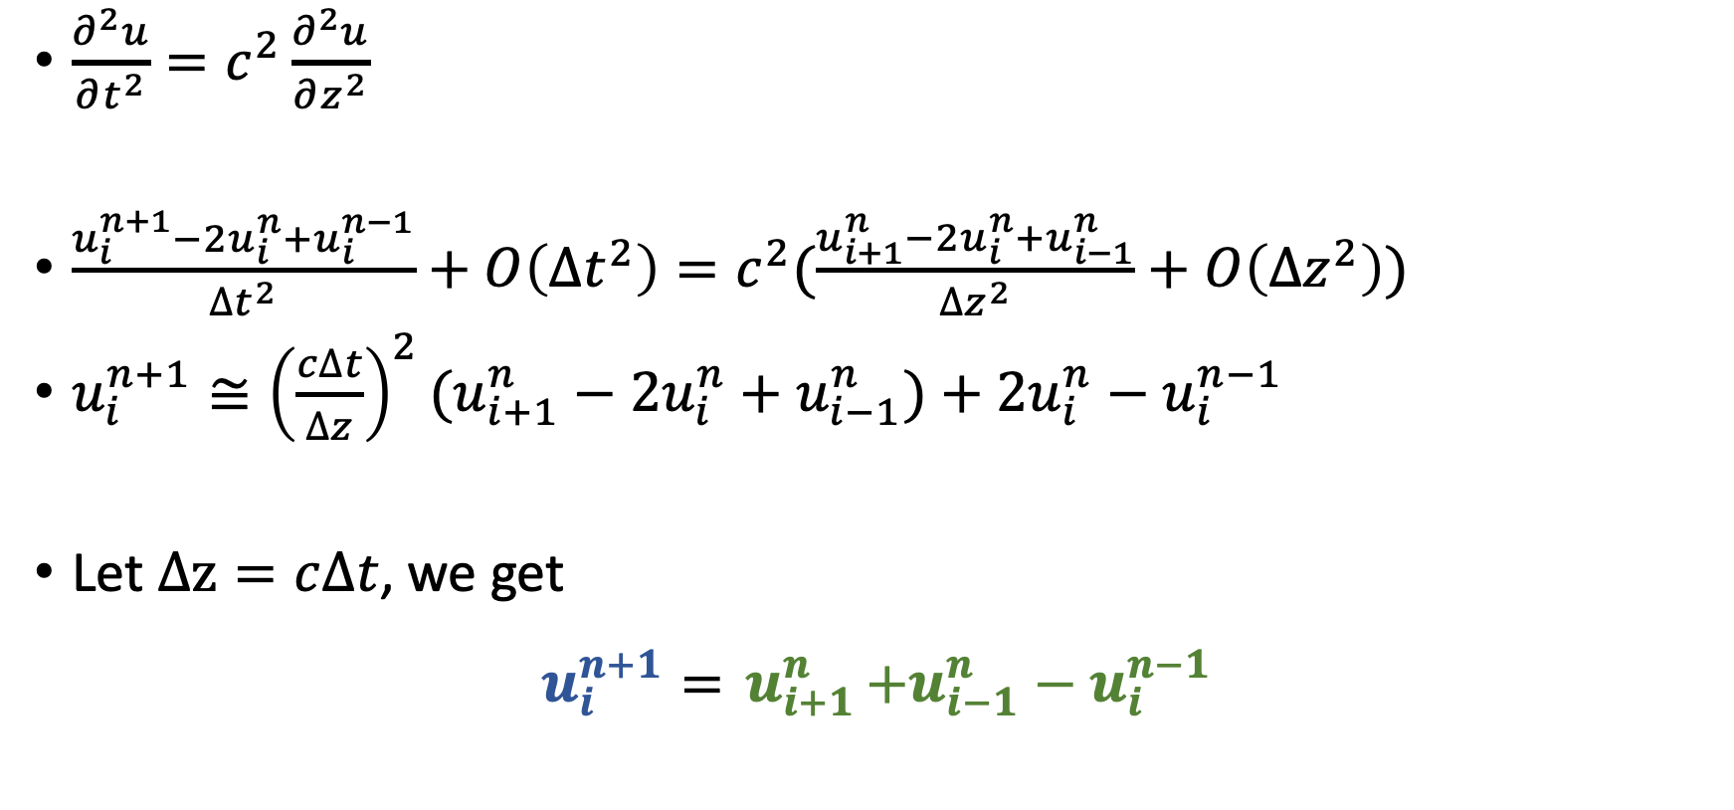
Dispersive equation
$\frac{∂^{2}u}{∂t^{2}}=c^{2}\frac{∂^{2}u}{∂z^{2}}$
$\frac{u_{i}^{n+1}−2u_{i}^{n}+u_{i}^{n−1}}{{∆t}^{2}}+O\left({∆t}^{2}\right)=c^{2}(\frac{u_{i+1}^{n}−2u_{i}^{n}+u_{i−1}^{n}}{{∆z}^{2}}+O\left({∆z}^{2}\right))$
$u_{i}^{n+1}≅{\left(\frac{c∆t}{∆z}\right)}^{2}(u_{i+1}^{n}−2u_{i}^{n}+u_{i−1}^{n})+2u_{i}^{n}−u_{i}^{n−1}$
Let $∆z=c∆t$, we get
$$u_{i}^{n+1}={ u}_{i+1}^{n}+u_{i−1}^{n}−u_{i}^{n−1}$$
Terms that you already know
Terms that you want to know

Slide 11

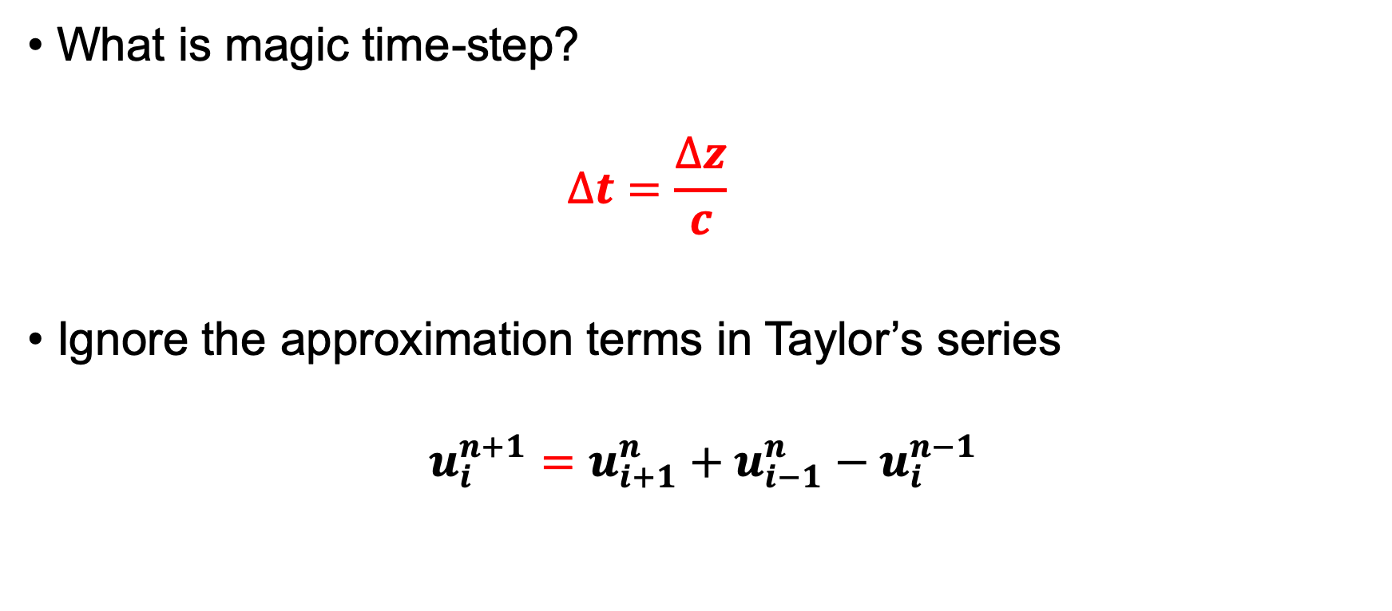
Magic time-step
What is magic time-step?
$$∆t=\frac{∆z}{c}$$
Ignore the approximation terms in Taylor’s series
$$u_{i}^{n+1}=u_{i+1}^{n}+u_{i−1}^{n}−u_{i}^{n−1}$$

Slide 12
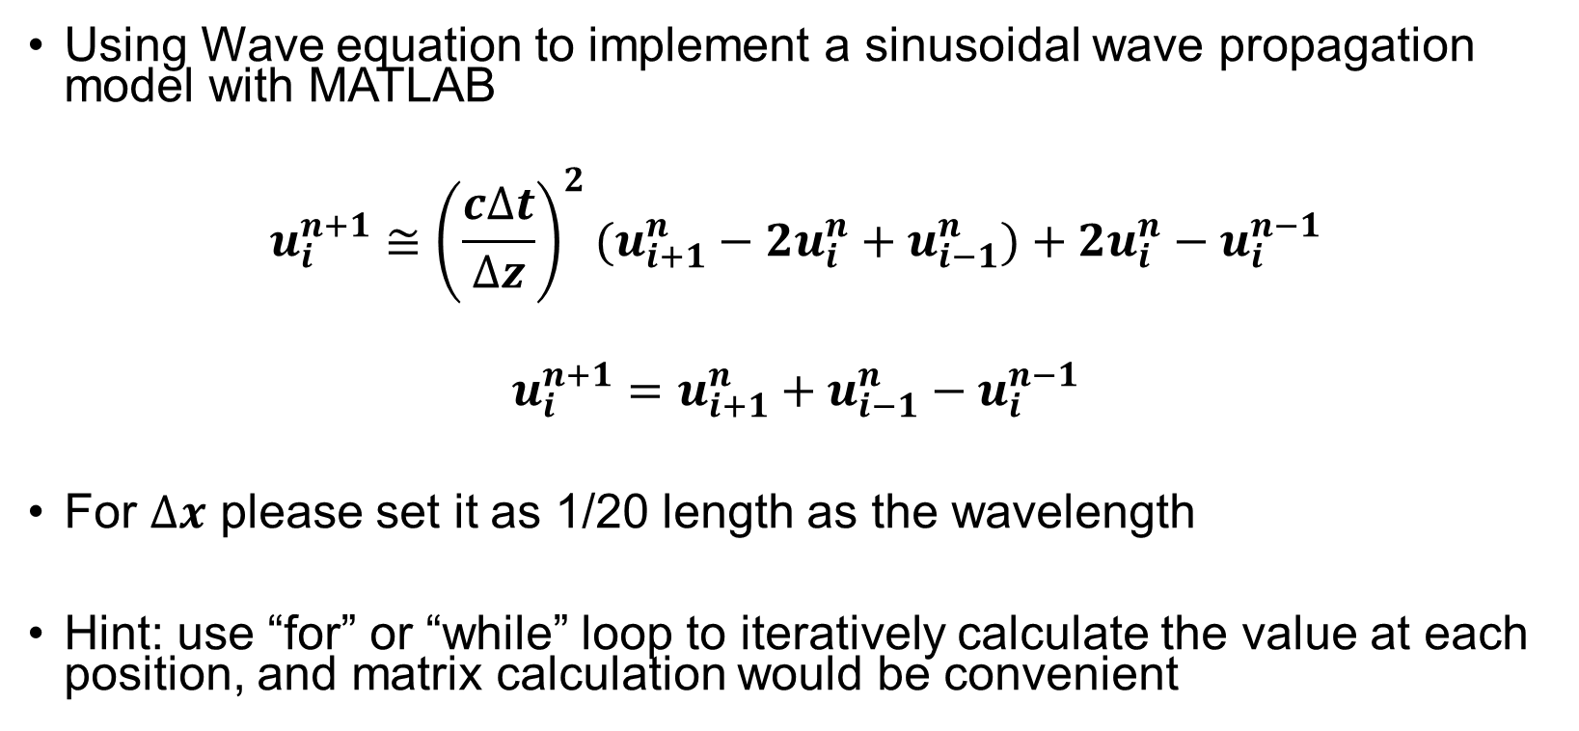
Exercise
Using Wave equation to implement a sinusoidal wave propagation model with MATLAB
$$u_{i}^{n+1}≅{\left(\frac{c∆t}{∆z}\right)}^{2}(u_{i+1}^{n}−2u_{i}^{n}+u_{i−1}^{n})+2u_{i}^{n}−u_{i}^{n−1}$$
$$u_{i}^{n+1}=u_{i+1}^{n}+u_{i−1}^{n}−u_{i}^{n−1}$$
For $∆x$ please set it as 1/20 length as the wavelength
Hint: use “for” or “while” loop to iteratively calculate the value at each position, and matrix calculation would be convenient

Slide 13
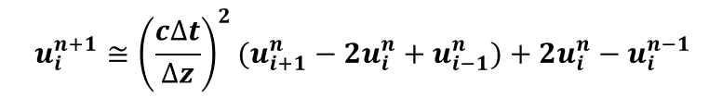
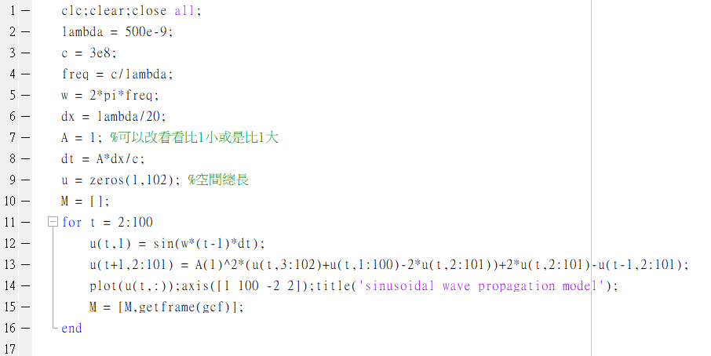
Ans

Slide 14
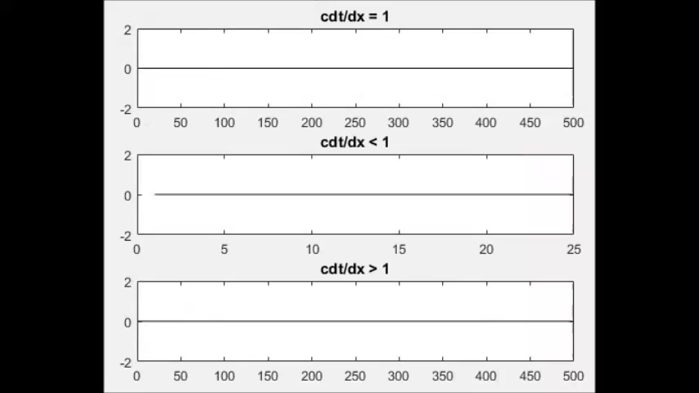
Discussion
cdt
cdt/dz
cdt/dz
dz
cdt
cdt/dz
?
?
dz

Slide 15
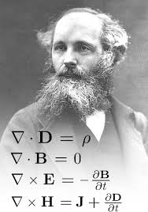
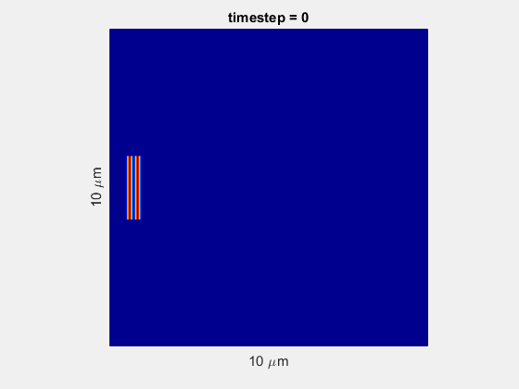
Computational Electrodynamics
Spatially sampling the electric and magnetic field vector
Ensure that every grid following Maxwell’s equations
Get the solution (distribution of field)

Slide 16
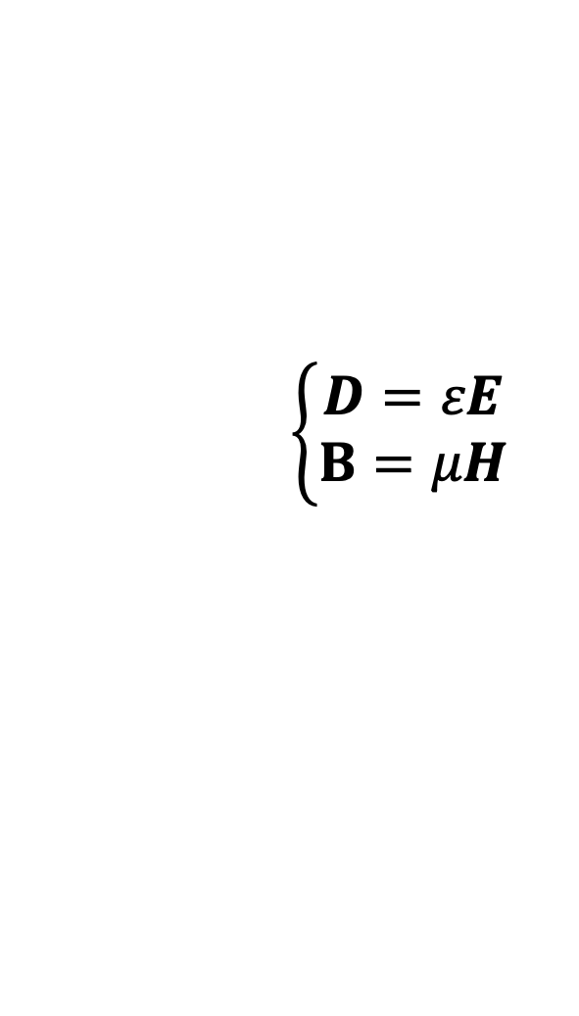
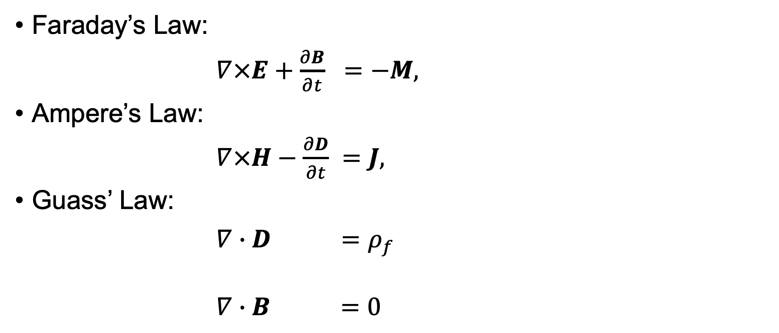
Maxwell’s equations
Faraday’s Law:
$∇×E+\frac{∂B}{∂t} =−M,$
Ampere’s Law:
$∇×H−\frac{∂D}{∂t} =J,$
Guass’ Law:
$∇∙D =ρ_{f}$
$∇∙B =0$
$$\left\{\begin{aligned}D=εE \\ B=μH\end{aligned}\right.$$

Slide 17
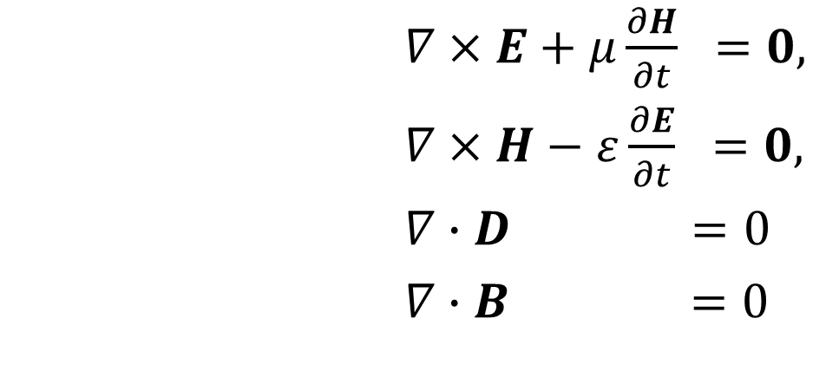
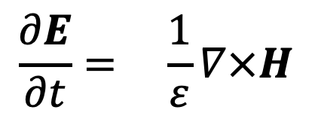
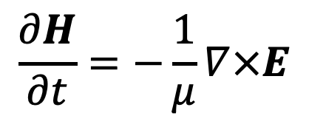
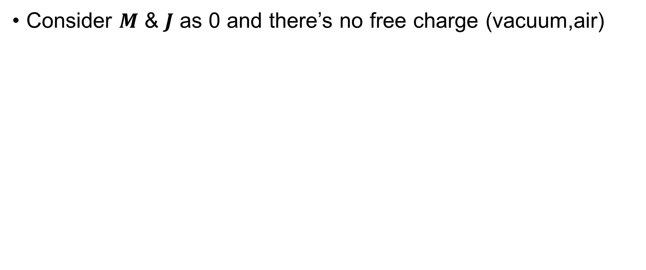
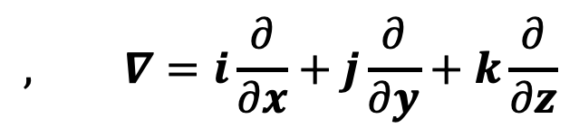
Maxwell’s equations
Consider $M$ & $J$ as 0 and there’s no free charge (vacuum,air)
$∇×E+μ\frac{∂H}{∂t} =0,$
$∇×H−ε\frac{∂E}{∂t} =0,$
$∇∙D =0$
$∇∙B =0$
$$\frac{∂H}{∂t}=−\frac{1}{μ}∇×E$$
$$, ∇=i\frac{∂}{∂x}+j\frac{∂}{∂y}+k\frac{∂}{∂z}$$
$$\frac{∂E}{∂t}= \frac{1}{ε}∇×H$$

Slide 18
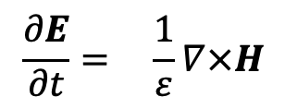
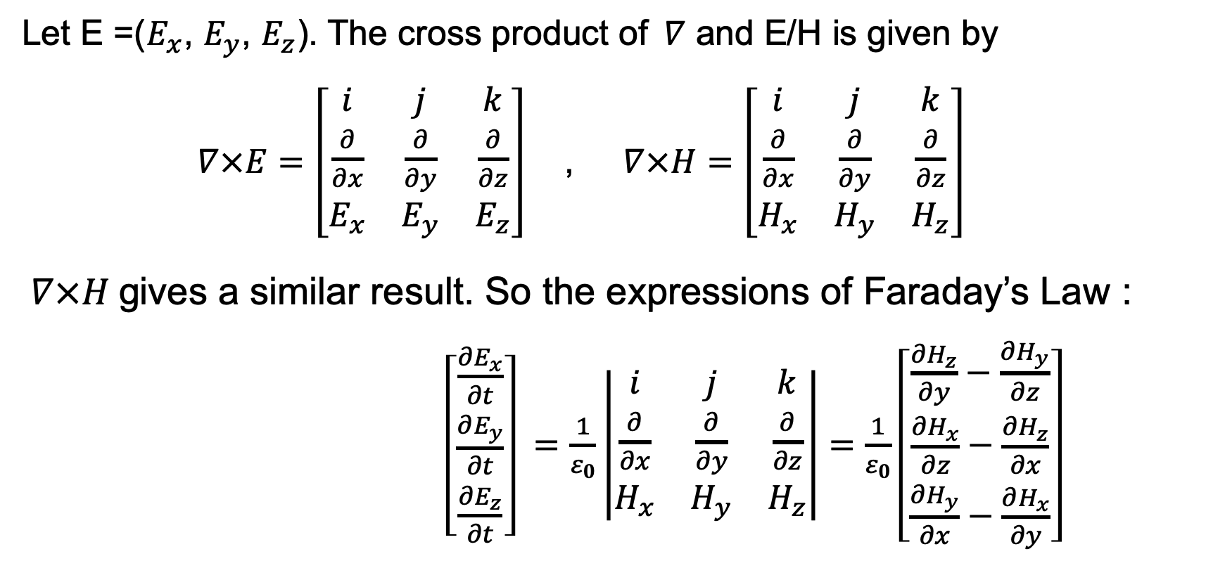
Maxwell’s equations
Let E =($E_{x}$, $E_{y}$, $E_{z}$). The cross product of$∇$ and E/H is given by $∇×E=\left[\begin{matrix}i & j & k \\ \frac{∂}{∂x} & \frac{∂}{∂y} & \frac{∂}{∂z} \\ E_{x} & E_{y} & E_{z}\end{matrix}\right]$ , $∇×H=\left[\begin{matrix}i & j & k \\ \frac{∂}{∂x} & \frac{∂}{∂y} & \frac{∂}{∂z} \\ H_{x} & H_{y} & H_{z}\end{matrix}\right]$ $∇×H$gives a similar result. So the expressions of Faraday’s Law : $\left[\begin{matrix}\frac{∂E_{x}}{∂t} \\ \frac{∂E_{y}}{∂t} \\ \frac{∂E_{z}}{∂t}\end{matrix}\right] =\frac{1}{ε_{0}}\left|\begin{matrix}i & j & k \\ \frac{∂}{∂x} & \frac{∂}{∂y} & \frac{∂}{∂z} \\ H_{x} & H_{y} & H_{z}\end{matrix}\right|=\frac{1}{ε_{0}}\left[\begin{matrix}\frac{∂H_{z}}{∂y}−\frac{∂H_{y}}{∂z} \\ \frac{∂H_{x}}{∂z}−\frac{∂H_{z}}{∂x} \\ \frac{∂H_{y}}{∂x}−\frac{∂H_{x}}{∂y}\end{matrix}\right]$
$$\frac{∂E}{∂t}= \frac{1}{ε}∇×H$$

Slide 19
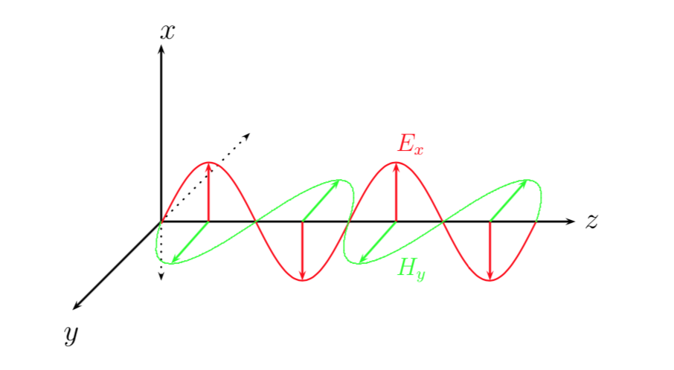
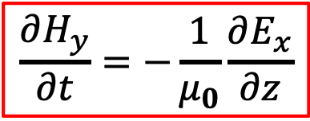
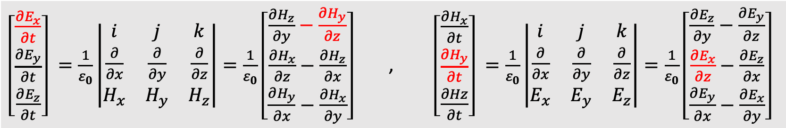
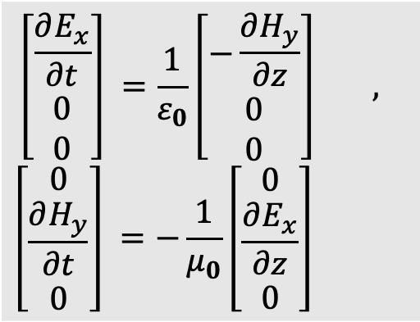
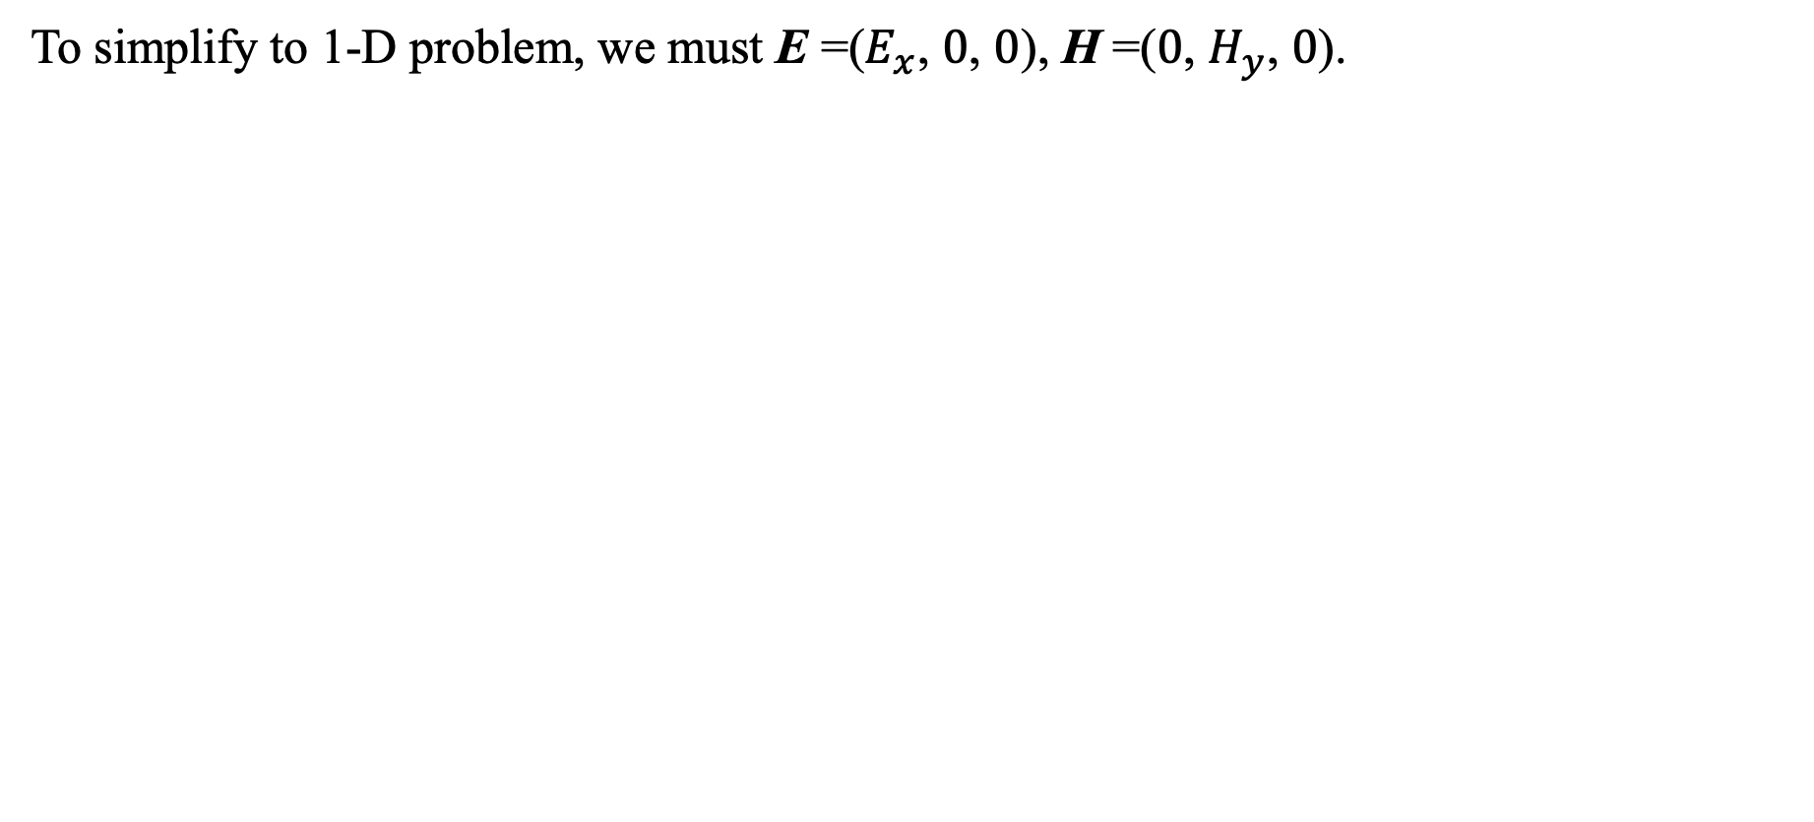
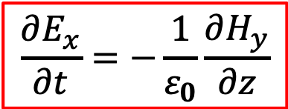
Maxwell’s equations
To simplify to 1-D problem, we must E =($E_{x}$, $0$, $0$), H =($0$, $H_{y}$, $0$).
$\left[\begin{matrix}\frac{∂E_{x}}{∂t} \\ \frac{∂E_{y}}{∂t} \\ \frac{∂E_{z}}{∂t}\end{matrix}\right] =\frac{1}{ε_{0}}\left|\begin{matrix}i & j & k \\ \frac{∂}{∂x} & \frac{∂}{∂y} & \frac{∂}{∂z} \\ H_{x} & H_{y} & H_{z}\end{matrix}\right|=\frac{1}{ε_{0}}\left[\begin{matrix}\frac{∂H_{z}}{∂y}−\frac{∂H_{y}}{∂z} \\ \frac{∂H_{x}}{∂z}−\frac{∂H_{z}}{∂x} \\ \frac{∂H_{y}}{∂x}−\frac{∂H_{x}}{∂y}\end{matrix}\right]$ , $\left[\begin{matrix}\frac{∂H_{x}}{∂t} \\ \frac{∂H_{y}}{∂t} \\ \frac{∂Hz}{∂t}\end{matrix}\right] =\frac{1}{ε_{0}}\left|\begin{matrix}i & j & k \\ \frac{∂}{∂x} & \frac{∂}{∂y} & \frac{∂}{∂z} \\ E_{x} & E_{y} & E_{z}\end{matrix}\right|=\frac{1}{ε_{0}}\left[\begin{matrix}\frac{∂E_{z}}{∂y}−\frac{∂E_{y}}{∂z} \\ \frac{∂E_{x}}{∂z}−\frac{∂E_{z}}{∂x} \\ \frac{∂E_{y}}{∂x}−\frac{∂E_{x}}{∂y}\end{matrix}\right]$
$$\frac{∂E_{x}}{∂t}=−\frac{1}{ε_{0}}\frac{∂H_{y}}{∂z}$$
$$\left[\begin{matrix}\frac{∂E_{x}}{∂t} \\ 0 \\ 0\end{matrix}\right] =\frac{1}{ε_{0}}\left[\begin{matrix}−\frac{∂H_{y}}{∂z} \\ 0 \\ 0\end{matrix}\right] ,$$
$$\left[\begin{matrix}0 \\ \frac{∂H_{y}}{∂t} \\ 0\end{matrix}\right] =−\frac{1}{μ_{0}}\left[\begin{matrix}0 \\ \frac{∂E_{x}}{∂z} \\ 0\end{matrix}\right]$$
$$\frac{∂H_{y}}{∂t}=−\frac{1}{μ_{0}}\frac{∂E_{x}}{∂z}$$

Slide 20

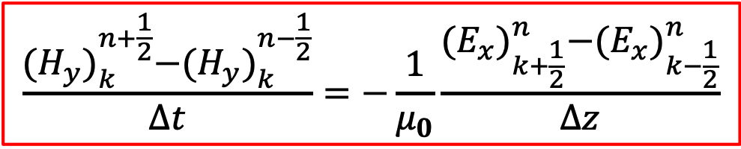
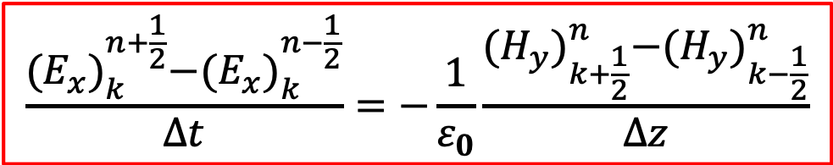
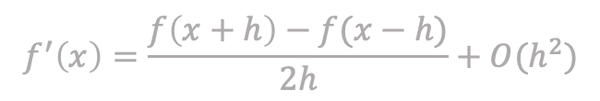
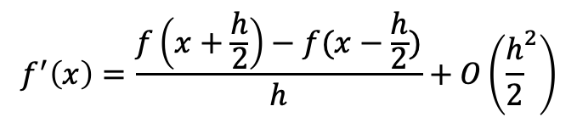
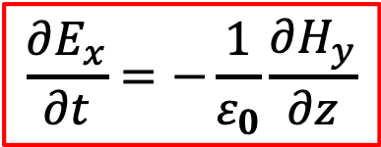
Maxwell’s equations
$$f^{′}\left(x\right)=\frac{f\left(x+h\right)−f(x−h)}{2h}+O(h^{2})$$
$$f^{′}\left(x\right)=\frac{f\left(x+\frac{h}{2}\right)−f(x−\frac{h}{2})}{h}+O\left({\frac{h}{2}}^{2}\right)$$
Dispersive equation!!
$$\frac{{(E_{x})}_{k}^{n+\frac{1}{2}}−{(E_{x})}_{k}^{n−\frac{1}{2}}}{∆t}=−\frac{1}{ε_{0}}\frac{{(H_{y})}_{k+\frac{1}{2}}^{n}−{(H_{y})}_{k−\frac{1}{2}}^{n}}{∆z}$$
$$\frac{∂E_{x}}{∂t}=−\frac{1}{ε_{0}}\frac{∂H_{y}}{∂z}$$
$$\frac{∂H_{y}}{∂t}=−\frac{1}{μ_{0}}\frac{∂E_{x}}{∂z}$$
$$\frac{{(H_{y})}_{k}^{n+\frac{1}{2}}−{(H_{y})}_{k}^{n−\frac{1}{2}}}{∆t}=−\frac{1}{μ_{0}}\frac{{(E_{x})}_{k+\frac{1}{2}}^{n}−{(E_{x})}_{k−\frac{1}{2}}^{n}}{∆z}$$

Slide 21
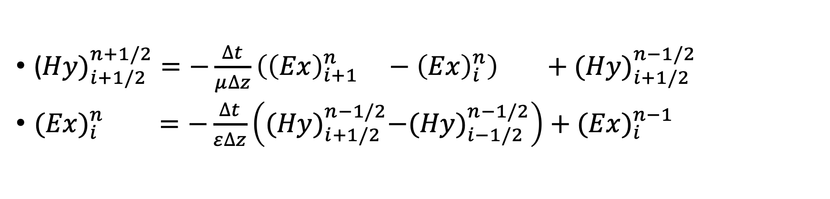


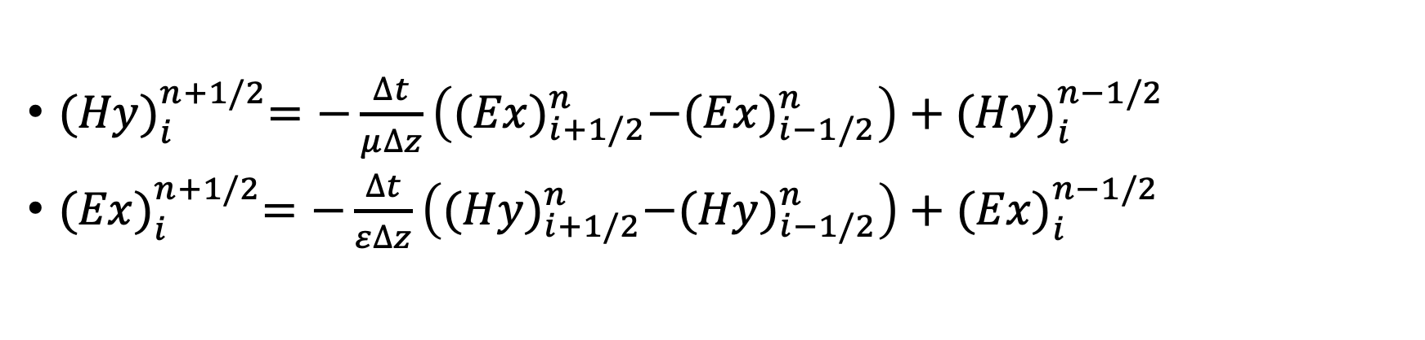
Maxwell’s equations
${(Hy)}_{i}^{n+1/2}=−\frac{∆t}{μ∆z}\left({(Ex)}_{i+1/2}^{n}−({Ex)}_{i−1/2}^{n}\right)+{(Hy)}_{i}^{n−1/2}$
${(Ex)}_{i}^{n+1/2}=−\frac{∆t}{ε∆z}\left({(Hy)}_{i+1/2}^{n}−{(Hy)}_{i−1/2}^{n}\right)+{(Ex)}_{i}^{n−1/2}$
$$i_{n} =i_{o}−1/2$$
(${Hy)}_{i+1/2}^{n+1/2}=−\frac{∆t}{μ∆z}\left({\left(Ex\right)}_{i+1}^{n} −{\left(Ex\right)}_{i}^{n}\right) +{(Hy)}_{i+1/2}^{n−1/2}$
${(Ex)}_{i}^{n} =−\frac{∆t}{ε∆z}\left({(Hy)}_{i+1/2}^{n−1/2}−{(Hy)}_{i−1/2}^{n−1/2}\right)+{(Ex)}_{i}^{n−1}$
$$n_{n}=n_{o}+1/2$$

Slide 22
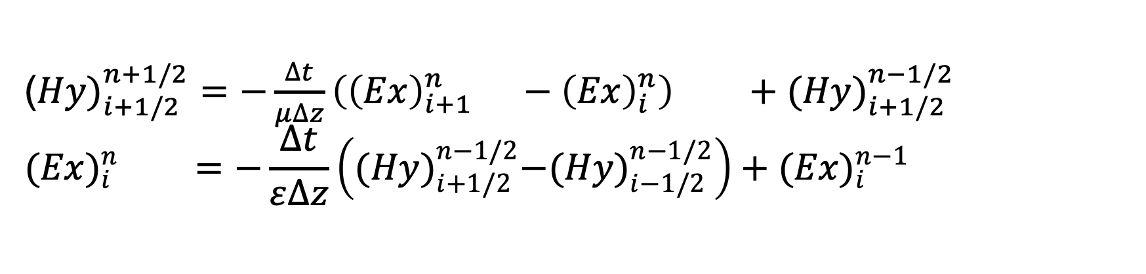


Maxwell’s equations
NO such a matrix has half of the position!!
(${Hy)}_{i+1/2}^{n+1/2}=−\frac{∆t}{μ∆z}\left({\left(Ex\right)}_{i+1}^{n} −{\left(Ex\right)}_{i}^{n}\right) +{(Hy)}_{i+1/2}^{n−1/2}$
$${(Ex)}_{i}^{n} =−\frac{∆t}{ε∆z}\left({(Hy)}_{i+1/2}^{n−1/2}−{(Hy)}_{i−1/2}^{n−1/2}\right)+{(Ex)}_{i}^{n−1}$$
2
E
3/2
H
1
E
t
$$\frac{3}{2}$$
$$\frac{5}{2}$$
1
2
3
…
i
z

Slide 23
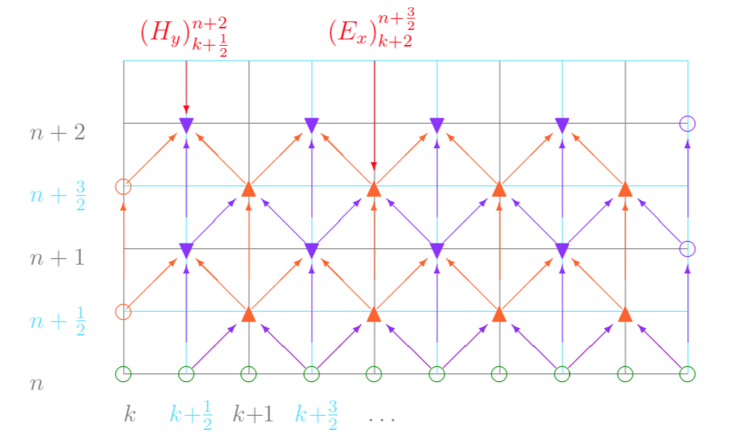
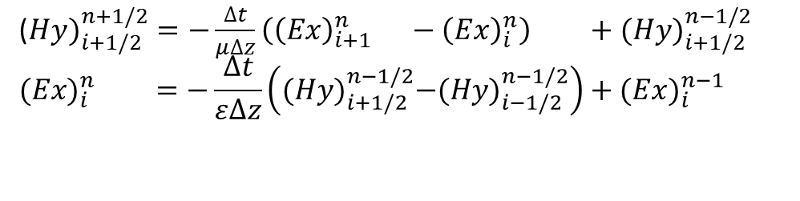
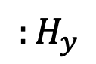
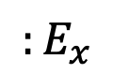
Maxwell’s equations
(${Hy)}_{i+1/2}^{n+1/2}=−\frac{∆t}{μ∆z}\left({\left(Ex\right)}_{i+1}^{n} −{\left(Ex\right)}_{i}^{n}\right) +{(Hy)}_{i+1/2}^{n−1/2}$
$${(Ex)}_{i}^{n} =−\frac{∆t}{ε∆z}\left({(Hy)}_{i+1/2}^{n−1/2}−{(Hy)}_{i−1/2}^{n−1/2}\right)+{(Ex)}_{i}^{n−1}$$
$${:E}_{x}$$
$${:H}_{y}$$

Slide 24
Yee’s grids
Spatially sampling the continue world into lots of grids
Store the electric and magnetic field data at integer and half respectively
Hx
Ez
Hy
Ez
Hz
Ey
Ey
Hz
Hy
Ex
Ex
Hx

Slide 25
Summary
This lecture started with 1-D wave simulation by Wave equation and used Taylor’s series to approximate the partial differential terms.
With magic time-step, we can ignore the error made by approximation.
Based on Maxwell’s equations and FDTD, we can simulate electromagnetic wave.

Slide 26
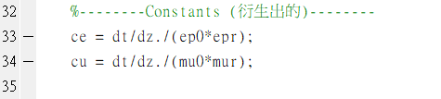
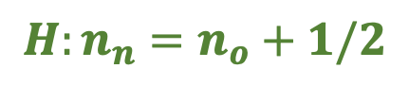
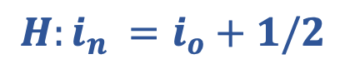
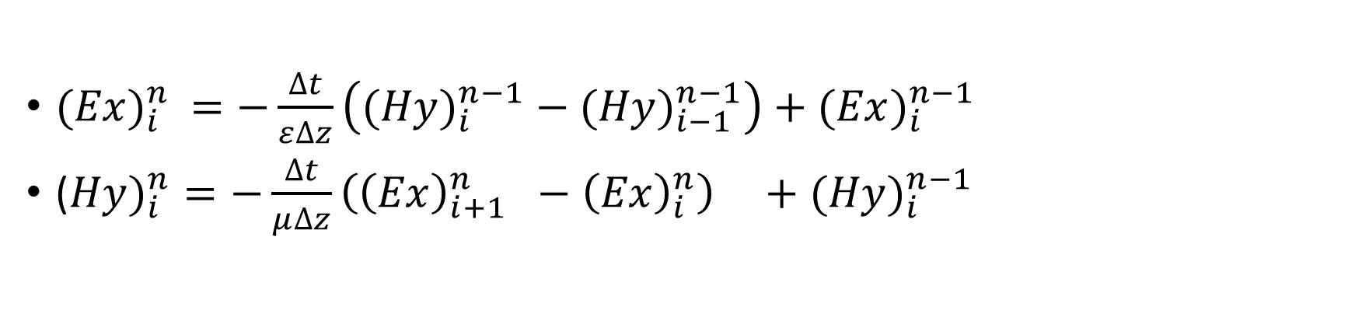
HW W2Q1
根據A_FDTD1dsimple.m 做出1D FDTD的架構
${(Ex)}_{i}^{n} =−\frac{∆t}{ε∆z}\left({(Hy)}_{i}^{n−1} − {(Hy)}_{i−1}^{n−1}\right)+{(Ex)}_{i}^{n−1}$
(${Hy)}_{i}^{n}=−\frac{∆t}{μ∆z}\left({\left(Ex\right)}_{i+1}^{n} −{\left(Ex\right)}_{i}^{n}\right) +{(Hy)}_{i}^{n−1}$
$${H:n}_{n}=n_{o}+1/2$$
$${H:i}_{n} =i_{o}+1/2$$

Slide 27




HW W2Q1
1. 電場向右傳
3. 電場向兩邊擴散
注意： 時間、長度、比例不是很重要， 重點是功能要到。
也請一併秀出磁場（轉換到跟電場同一比例）
2. 電場向左傳
4. 電場由中間升起後，
向兩旁擴散

Slide 28

HW W2Q1
5. 形成駐波
注意： 時間、長度、比例不是很重要， 重點是功能要到。
也請一併秀出磁場（轉換到跟電場同一比例）

Slide 29



HW W2Q1
$ε_{2}$=${2∗ε}_{0}$
$ε_{1}$=$ε_{0}$
6. 形成反射
注意： 時間、長度、比例不是很重要， 重點是功能要到。
也請一併秀出磁場（轉換到跟電場同一比例）

Slide 30

HW W2Q1
最終成果如右圖!
(此次作業會給老師過目)
延伸題 :
觀察-Z傳遞會發現會有一個小隆起往+Z傳!
1. 請量化它
2. 你覺得為何會產生小隆起
3. 如何使小隆起變小或消失

Slide 31




Hint1
(1)
$Gaus\left(x\right)=In∗exp⁡[−\frac{{(x−x_{0})}^{2}}{2∗∆^{2}}$]
(2)
電磁波關係式
$$B=\frac{1}{ω}k×E$$

Slide 32

Hint2

Slide 33
References
A. Taflove, Computational Electrodynamics: The Finite-Difference Time-Domain Method. Norwood, MA: Artech House, (1995)
https://ir.nctu.edu.tw/bitstream/11536/70135/5/356905.pdf
http://www.cavelab.cs.tsukuba.ac.jp/nsfdtd/theory/beginner_04.html
https://www.mathworks.com/matlabcentral/fileexchange/34996-program15-1d-fdtd-with-mur-s-absorbing-boundary-condition

